Slide 1


SIS Attendance Module

Slide 2

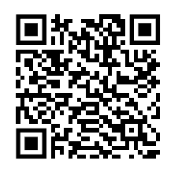

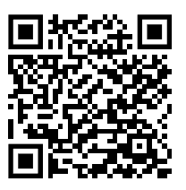

BİLGİCampus Mobile Application
Scan the relevant QR code to install the BİLGİCampus application on your mobile device.

Slide 3
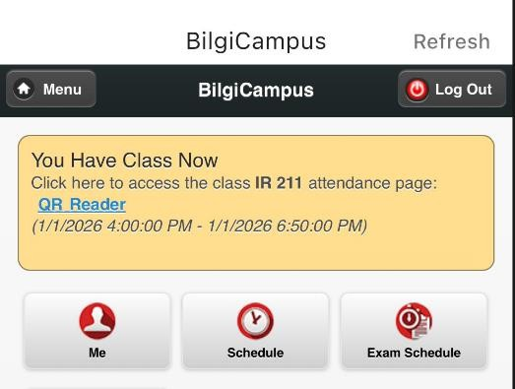
BİLGİCampus –
Connect to the BİLGİSecure wireless network.
Open the BİLGİCampus mobile application and log in with your BİLGİ account.
An attendance notification for your upcoming class will appear on the home page.
In the classroom, click the link to complete your attendance check-in.

Slide 4
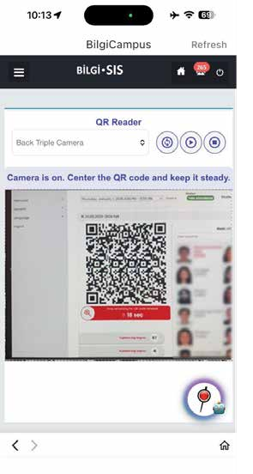
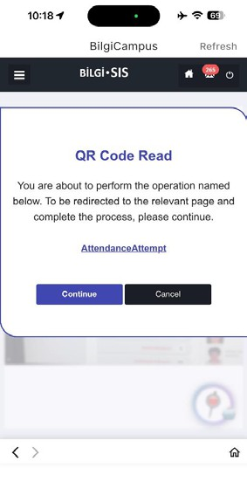
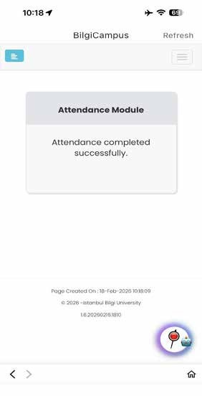
BİLGİCampus- Complete Attendance via QR Code
Scan the QR code displayed on the screen and complete the attendance process.

Slide 5
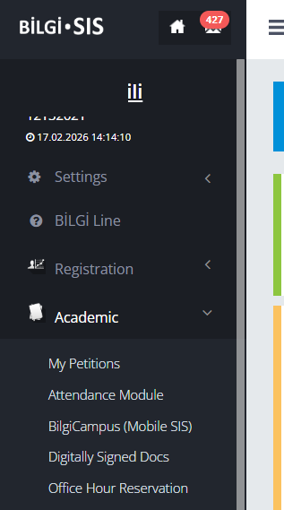
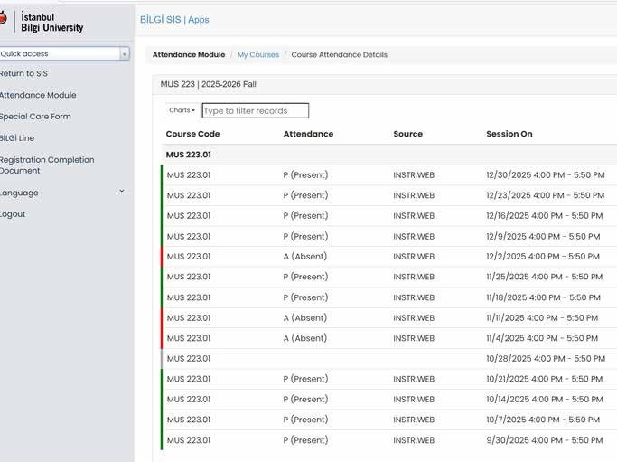
SIS Website- Attendance Report
You can view the attendance report by accessing the Attendance Module from the menu and selecting the relevant course.

Slide 6

Thank you.

